Slide 1
Software module for autonomous car
Guide: Dr. Ramkrishna Pasumarthy
Name: Rahil Shah
Roll number: EE20B104

Slide 2
Abstract
This project explores a deep learning-based software module for safe navigation in one-tenth scale autonomous cars. YOLOP enables scene segmentation and path planning, while depth estimation methods are investigated for improved accuracy. Scaled vehicles serve as a controlled environment for studying V2V/V2I communication and cooperative behavior. Collaborative research aims to advance autonomous vehicle technology.

Slide 3
Acknowledgements
Dr. Ramkrishna Pasumarthy:
Your mentorship and insightful guidance played a pivotal role in steering the project towards success.
Dr. Nirav Bhatt:
Your valuable contributions and mentorship have been invaluable throughout the project.
Subhadeep Sir:
I extend my gratitude to Subhadeep Sir for his pivotal role in this project. His expertise in Jetson Nano, guidance on library compatibility, and insights into code optimization were instrumental. His assistance in capturing images with the car significantly enhanced project outcomes.
Soumyajit sir:
His expertise in deep learning and computer vision, coupled with insightful discussions, significantly contributed to the project's technical depth and understanding.
Vasumathi ma’am:
Her indispensable assistance in experimental setup ensured meticulous design and precise data collection, crucial for successful experimentation.

Slide 4
Introduction
The project addresses the need for sophisticated software modules to enable autonomous vehicle navigation, focusing on enhancing safety and efficiency.
Tailored for one-tenth scale autonomous cars, the project aims to enrich navigation capabilities through scene segmentation, path planning, waypoint derivation, and depth estimation.
Drawing on advanced algorithms from computer vision, deep learning, and robotics, the project empowers vehicles to comprehend their environment and navigate safely and efficiently.

Slide 5
Problem Statement
Objective: Drive the car autonomously using only front cameras as sensors.
Challenges:
Identifying the drivable area from camera feeds.
Generating waypoints for navigation.
Mapping waypoints to 3D coordinates.
And then drive the car over it.
Approach: Develop algorithms to address each challenge sequentially, enabling the car to navigate autonomously based on camera inputs.

Slide 6
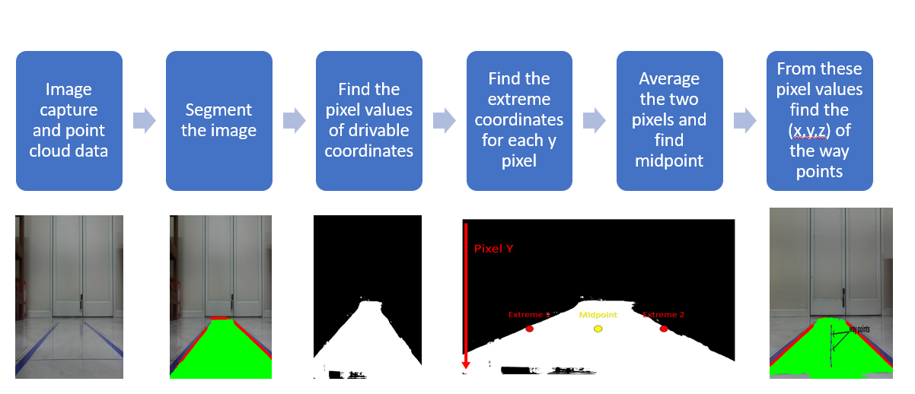
Flow of the project

Slide 7
Segmentation

Slide 8
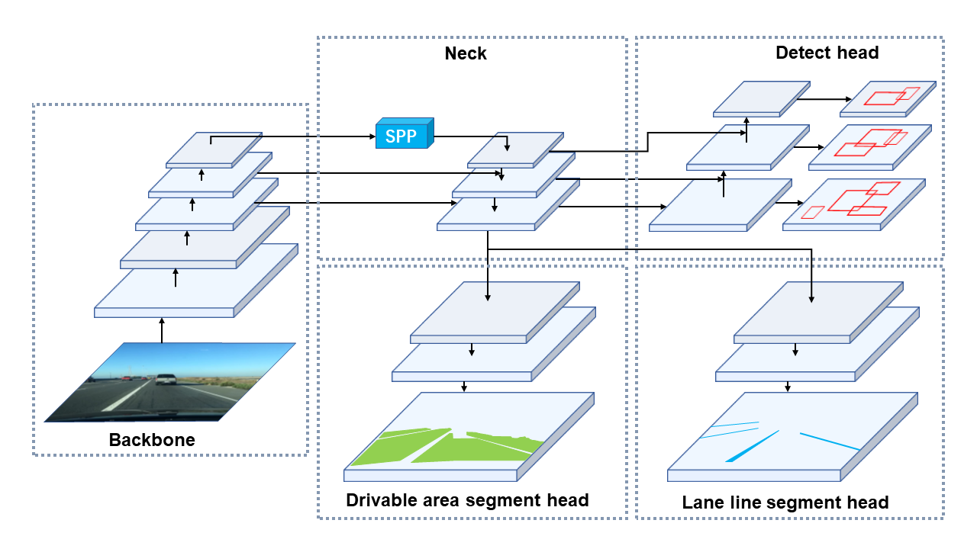
Segmentation of the drivable area
We utilize the YOLOP model for the segmentation of the drivable area.
You Only Look Once for Panoptic Driving Perception (YOLOP):
YOLOP architecture chosen for its real-time processing capabilities.
Purpose-built for panoptic driving perception, integrating object detection and scene segmentation.
Advantages for Autonomous Vehicles:
Enables simultaneous detection and segmentation of objects in real-time.
Optimized for deployment on edge devices like the Jetson Nano, aligning with resource constraints.

Slide 9
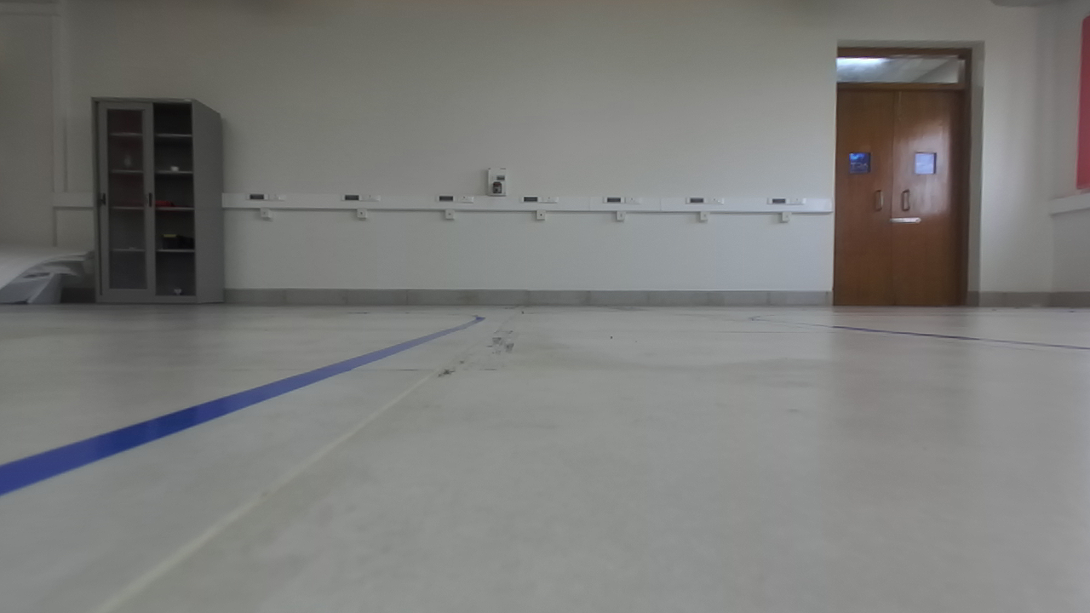
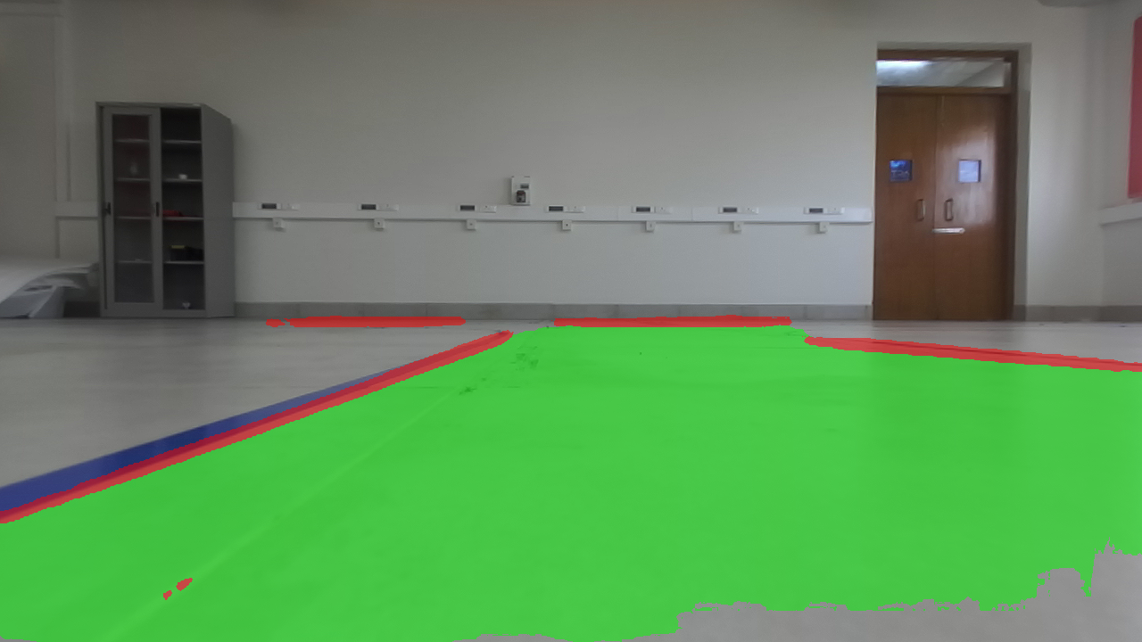
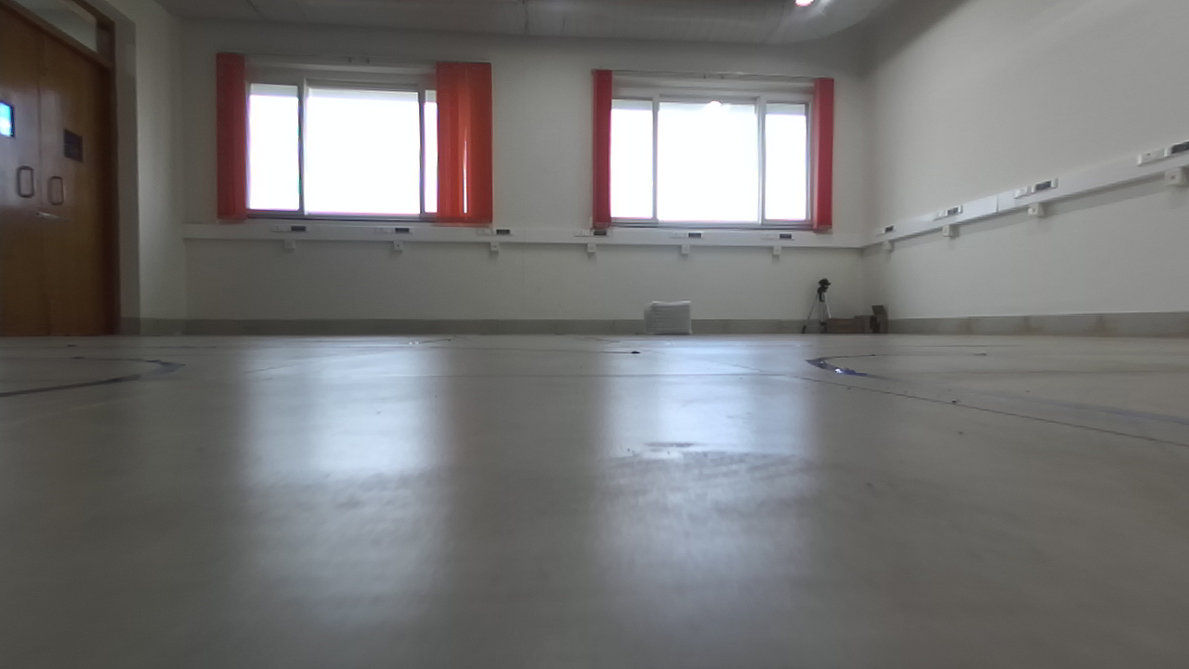
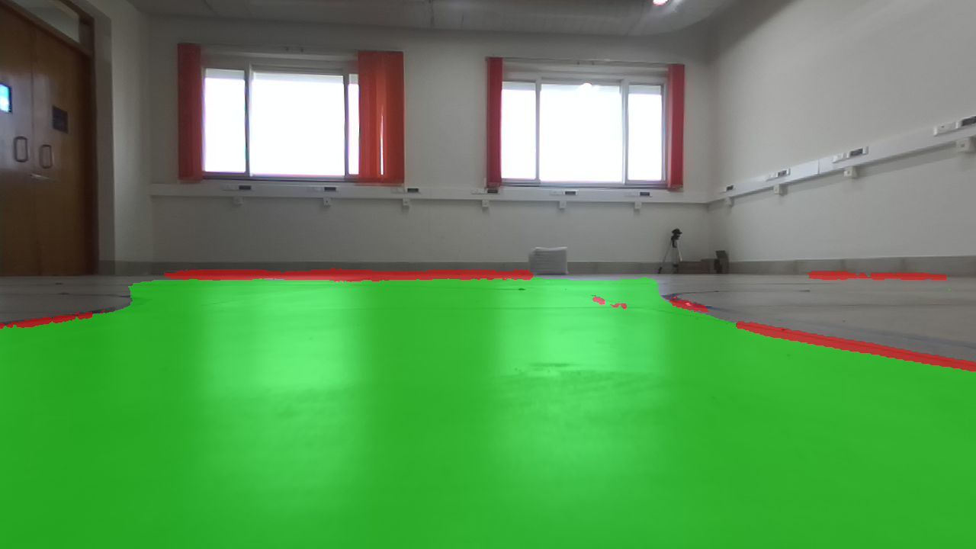
Results
Image
Prediction

Slide 10
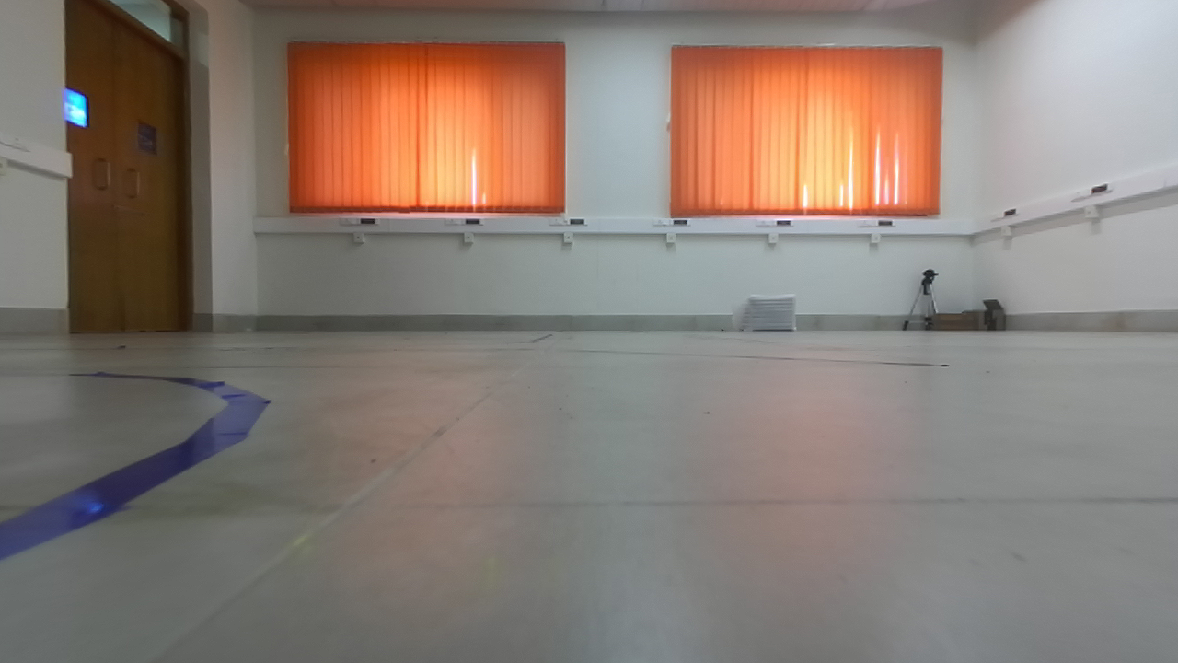
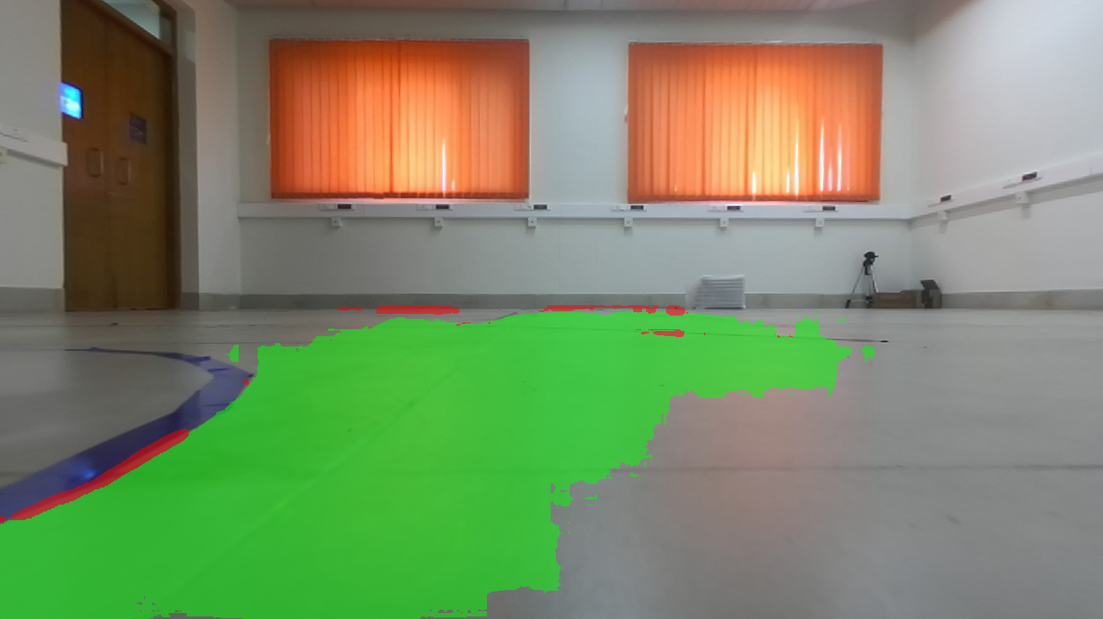
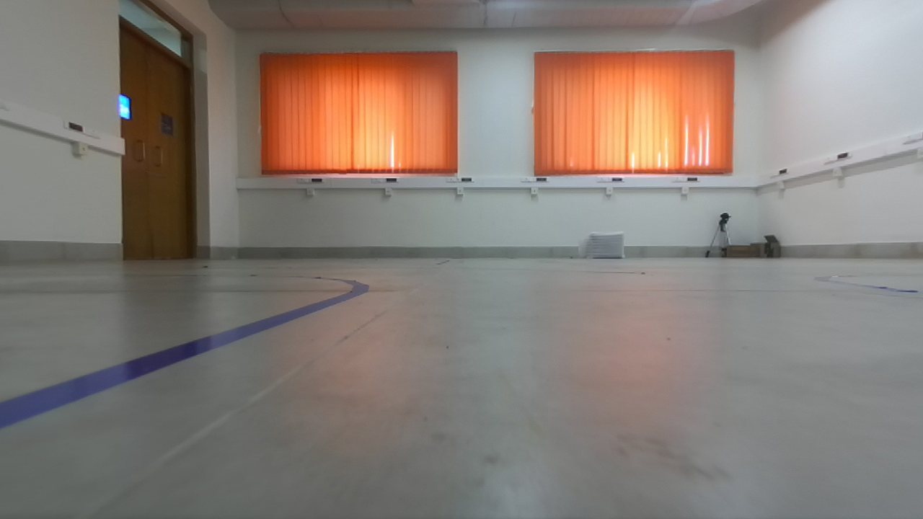
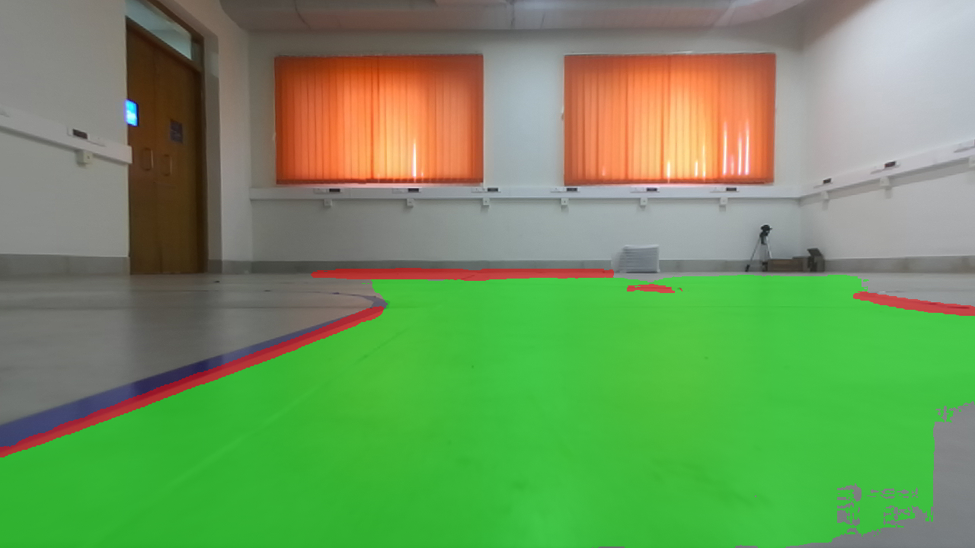
Results
Image
Prediction

Slide 11
Way point estimation

Slide 12
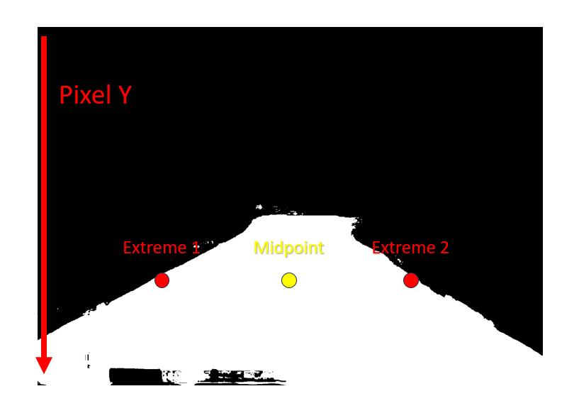
Way point estimation algorithm
Perform image segmentation to identify drivable area.
Extract the extreme points corresponding to white pixels along a given horizontal line.
Iterate this process for the entire image.
Compute midpoints of these values.
Then choose these as our way points.

Slide 13

Error control mechanism and outlier removal
Outlier Impact: Outliers can significantly distort waypoint estimation, leading to erroneous navigation decisions.
Introduction of 2-Pointer Algorithm: Developed and implemented to mitigate the effects of outliers on waypoint accuracy.
Objective: The 2-Pointer Algorithm aims to control errors and reduce the impact of outliers, ensuring more reliable and precise navigation.

Slide 14
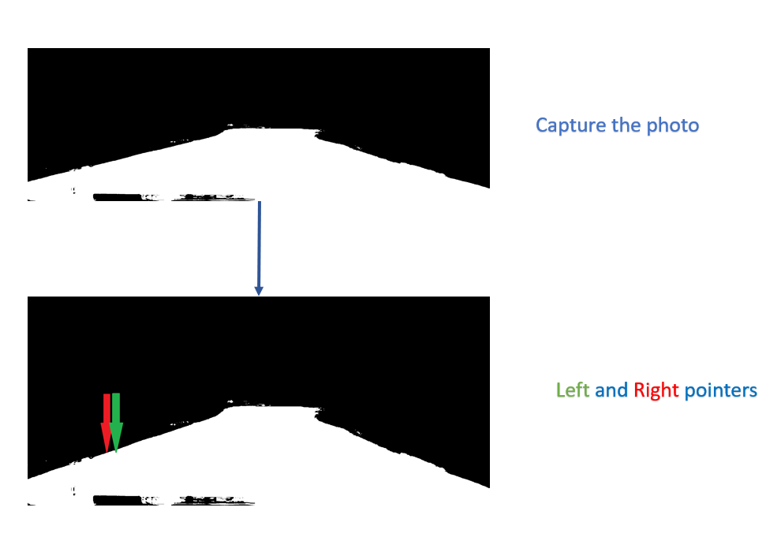
2 Pointer Algorithm - I

Slide 15
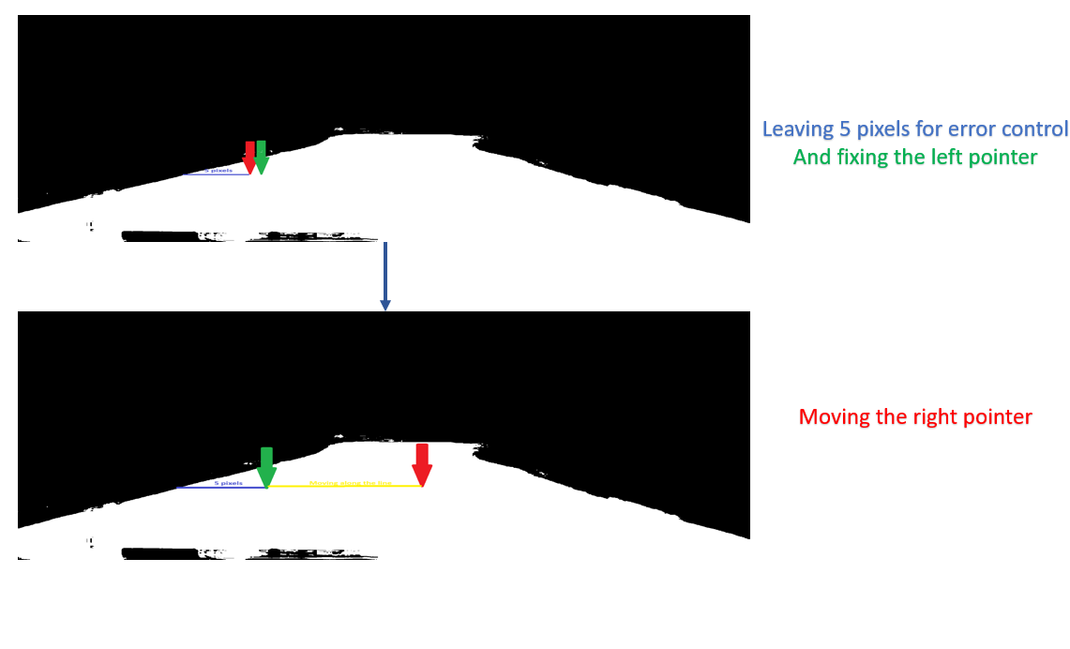
2 Pointer Algorithm - II

Slide 16
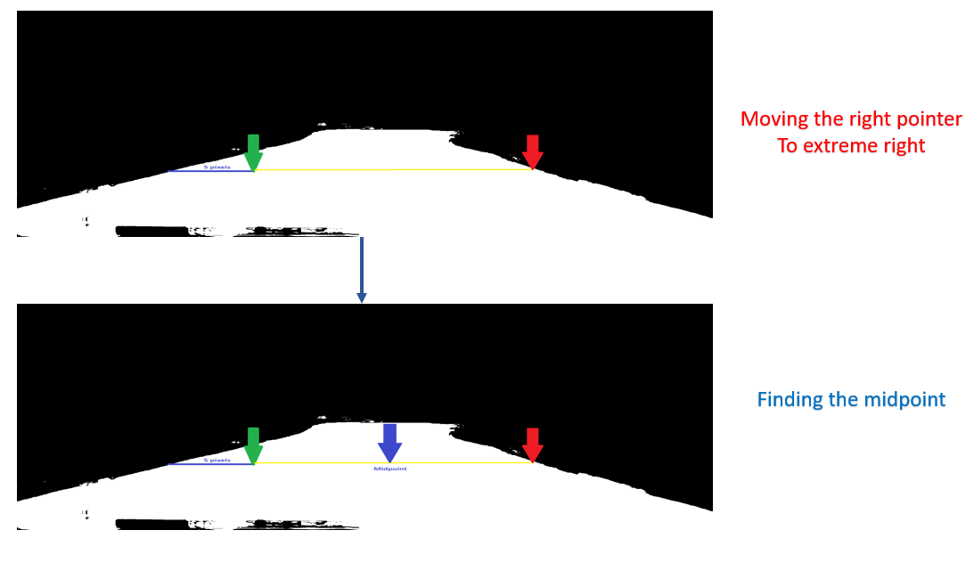
2 Pointer Algorithm - III

Slide 17
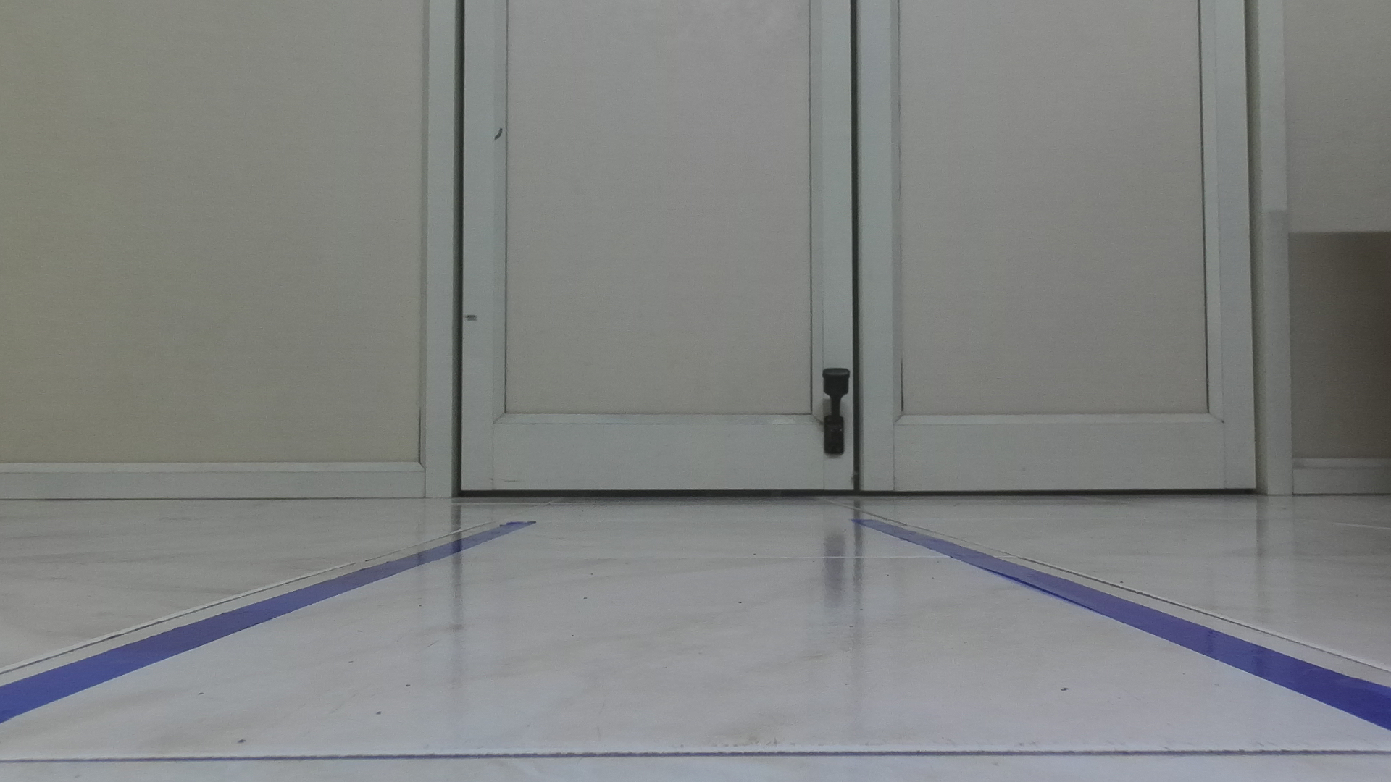
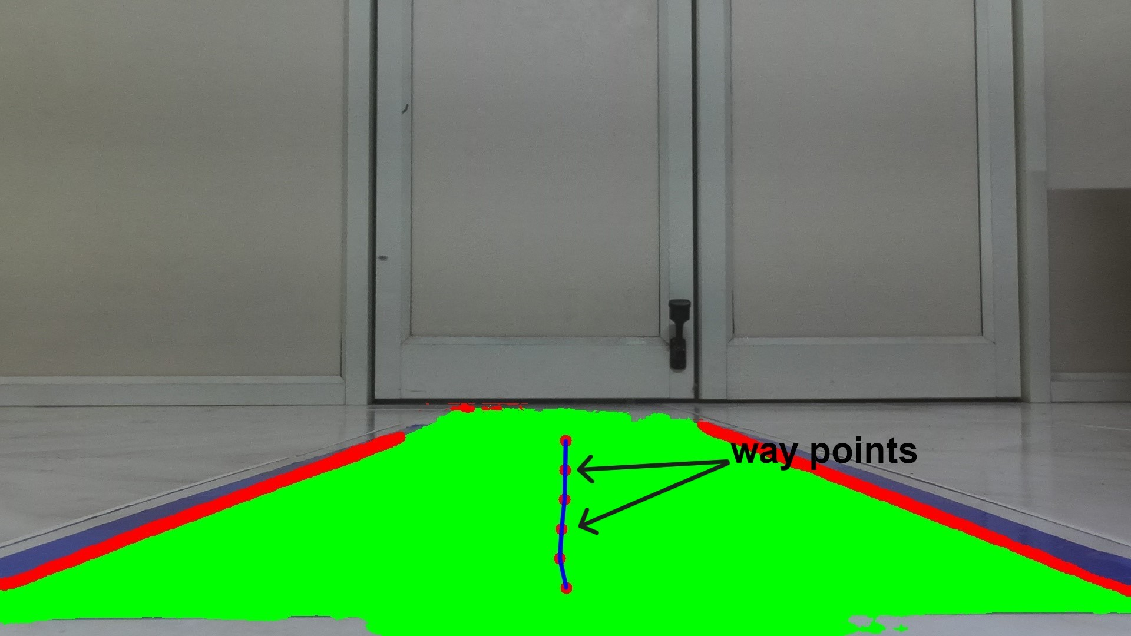
Results (straight path)
Image
Prediction

Slide 18
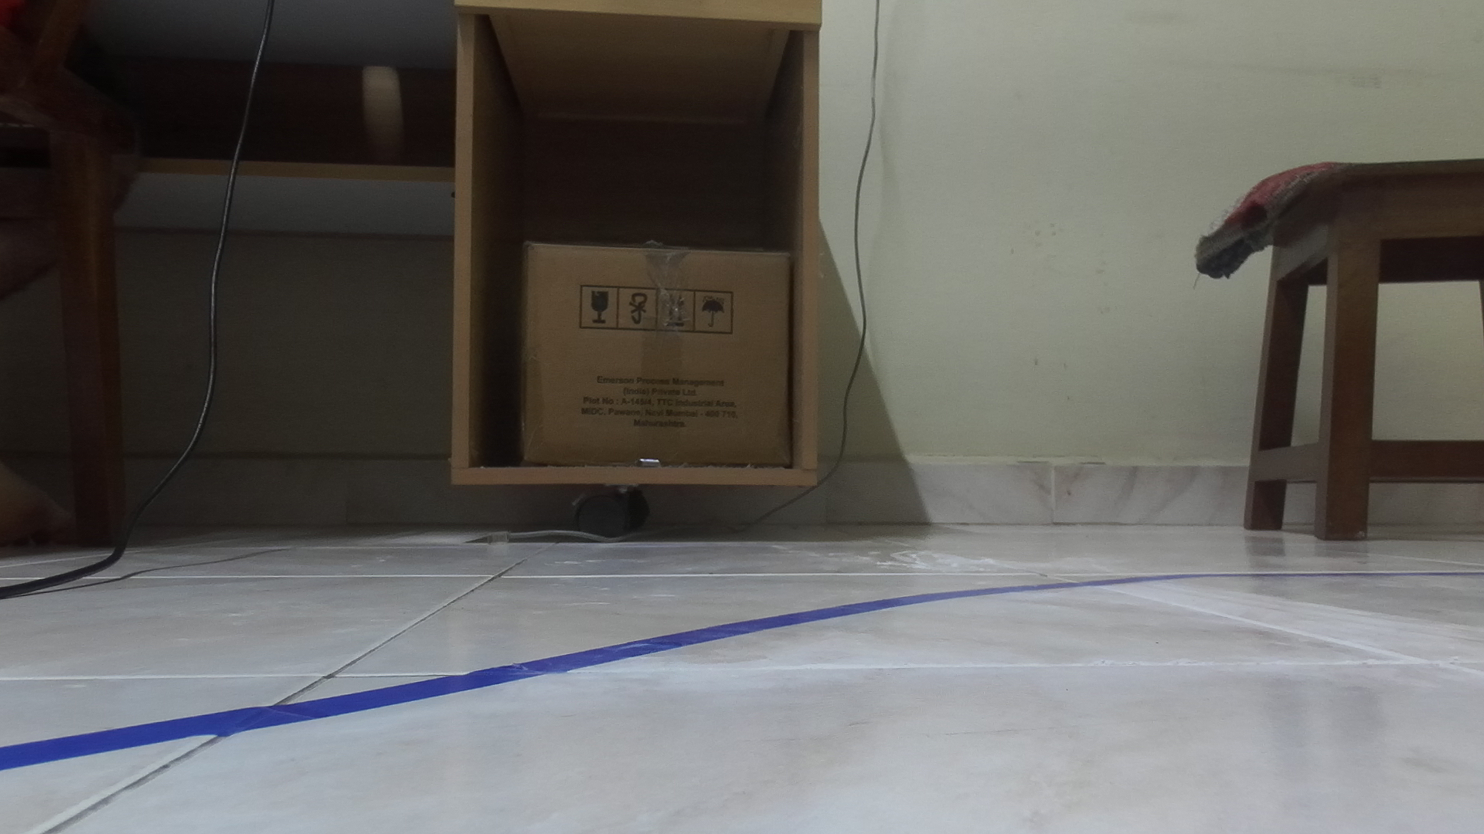
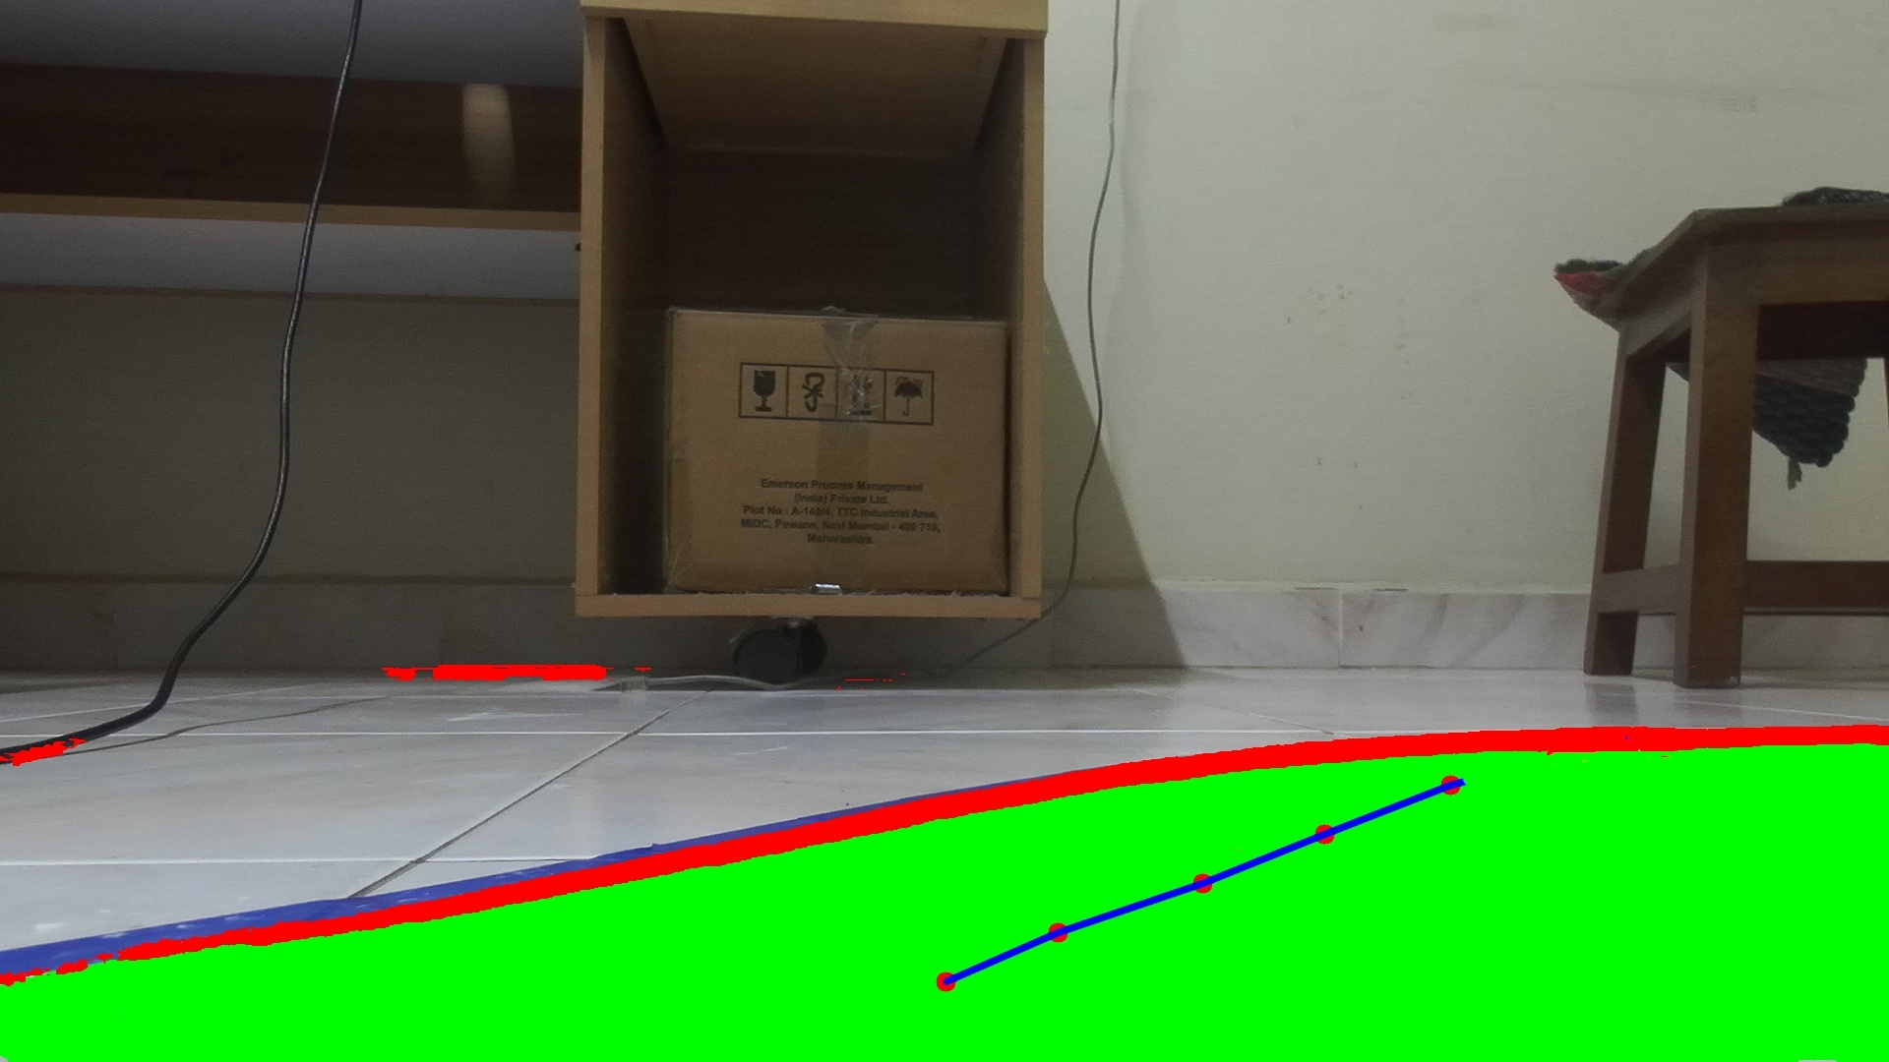
Results (right turn)
Image
Prediction

Slide 19
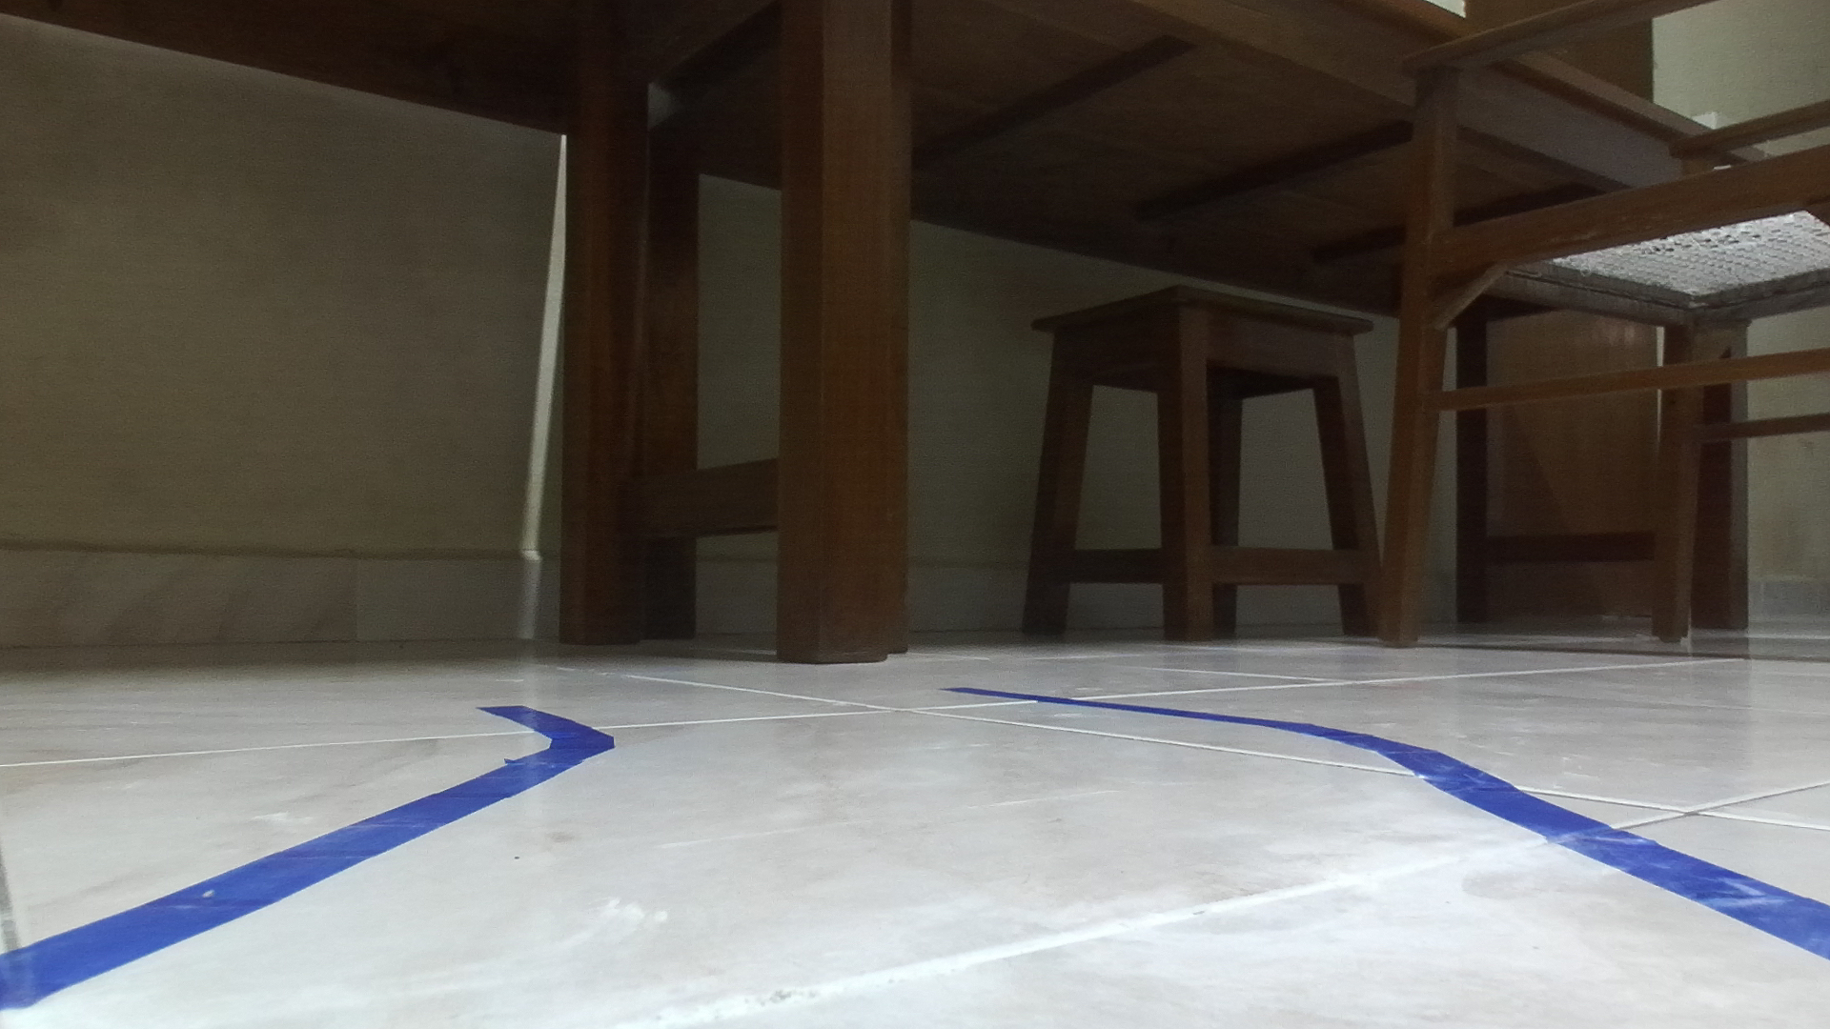
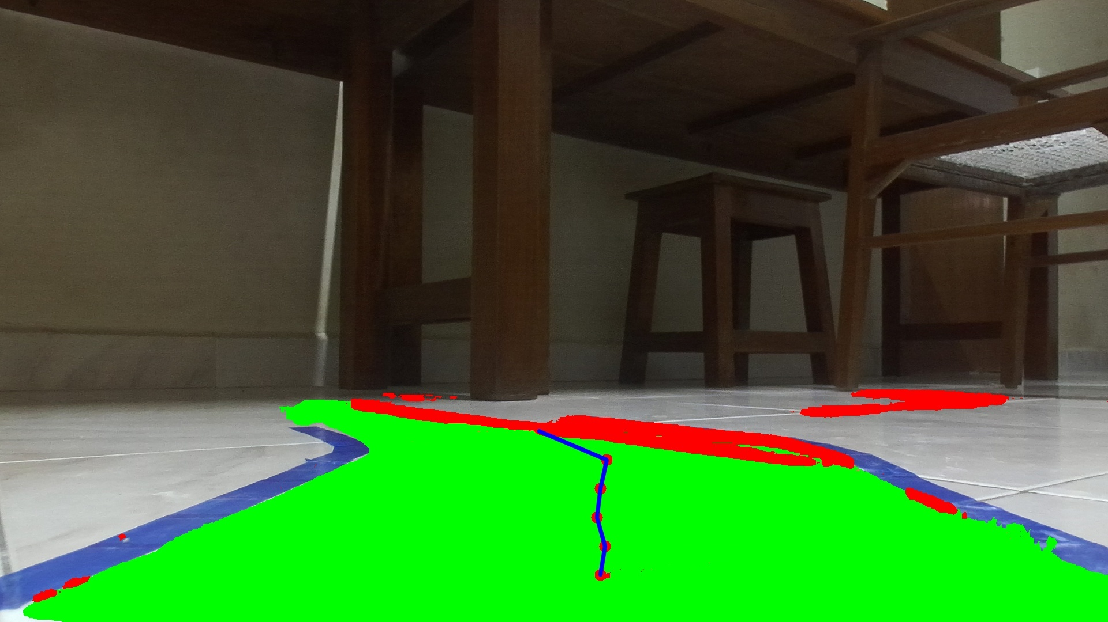
Results (left turn)
Image
Prediction

Slide 20
The depth estimation problem

Slide 21
Estimating the x-y coordinates
Why is it necessary?
Precision in Navigation:
Accurate x-y coordinates ensure the vehicle follows the exact path intended for safe and efficient navigation.
Control Module Integration:
The control module requires precise waypoint data to determine the vehicle's movements and steering actions.
Accurate Movement:
Estimating waypoints allows the vehicle to move accurately along the path, avoiding obstacles and ensuring smooth travel.

Slide 22
Capturing the depth using zed

Slide 23
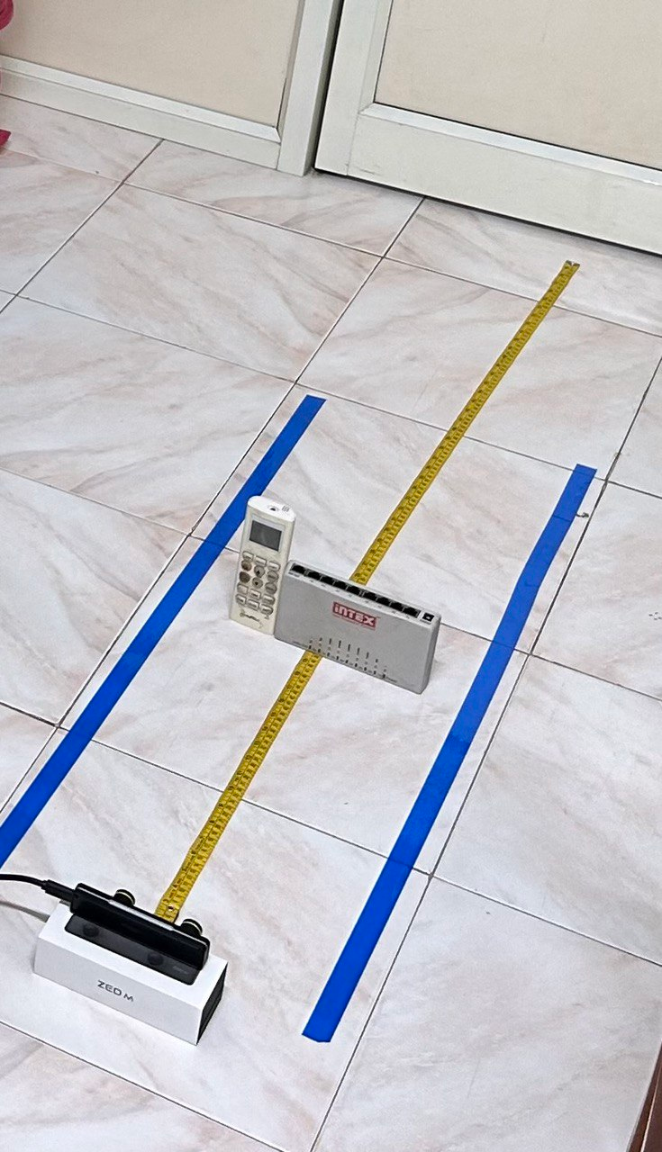
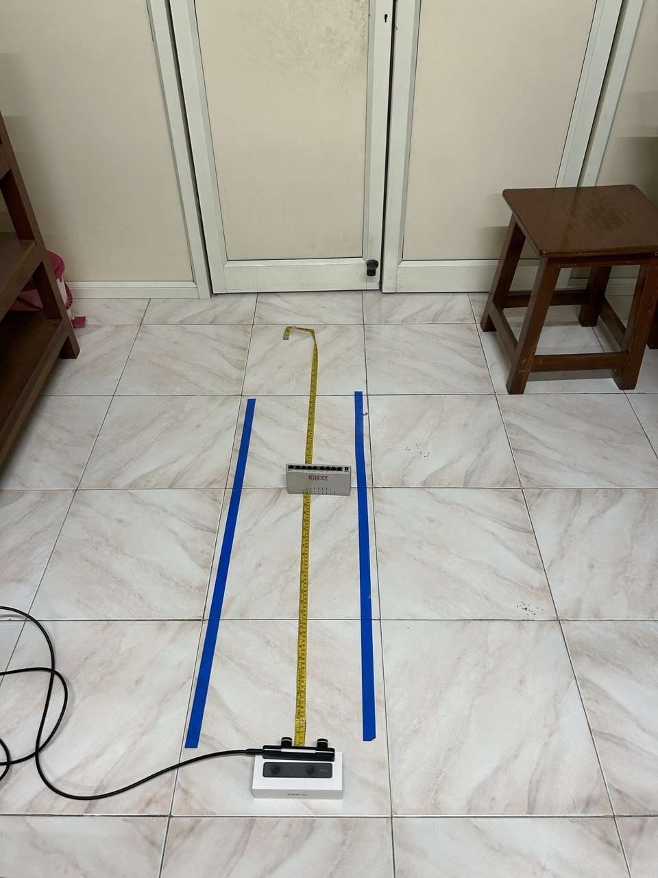
Experiment for measuring the depth
Camera is kept at the height of 5.5 cm as that is present on the car

Slide 24
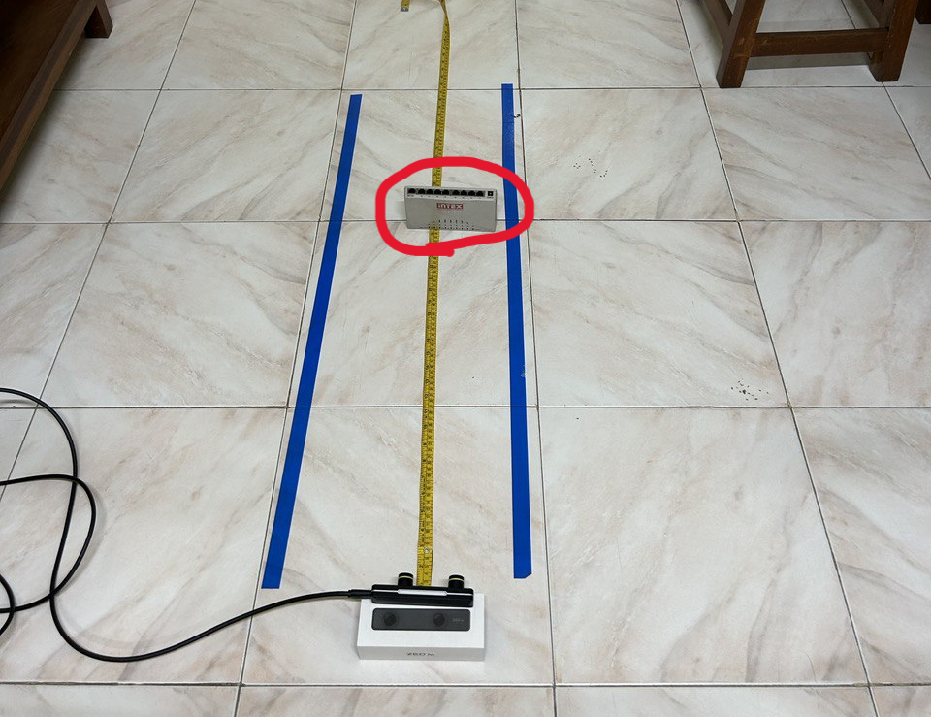
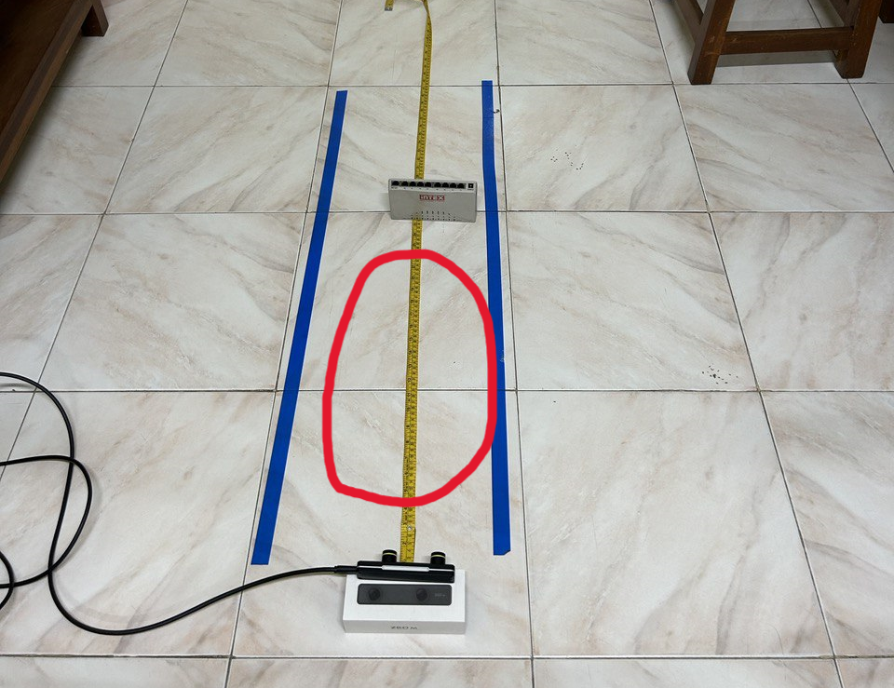
Results for the above experiments
Works very well for the measuring the depth of the object.
However doesn’t work at all to get the depth of the other coordinates on the ground

Slide 25
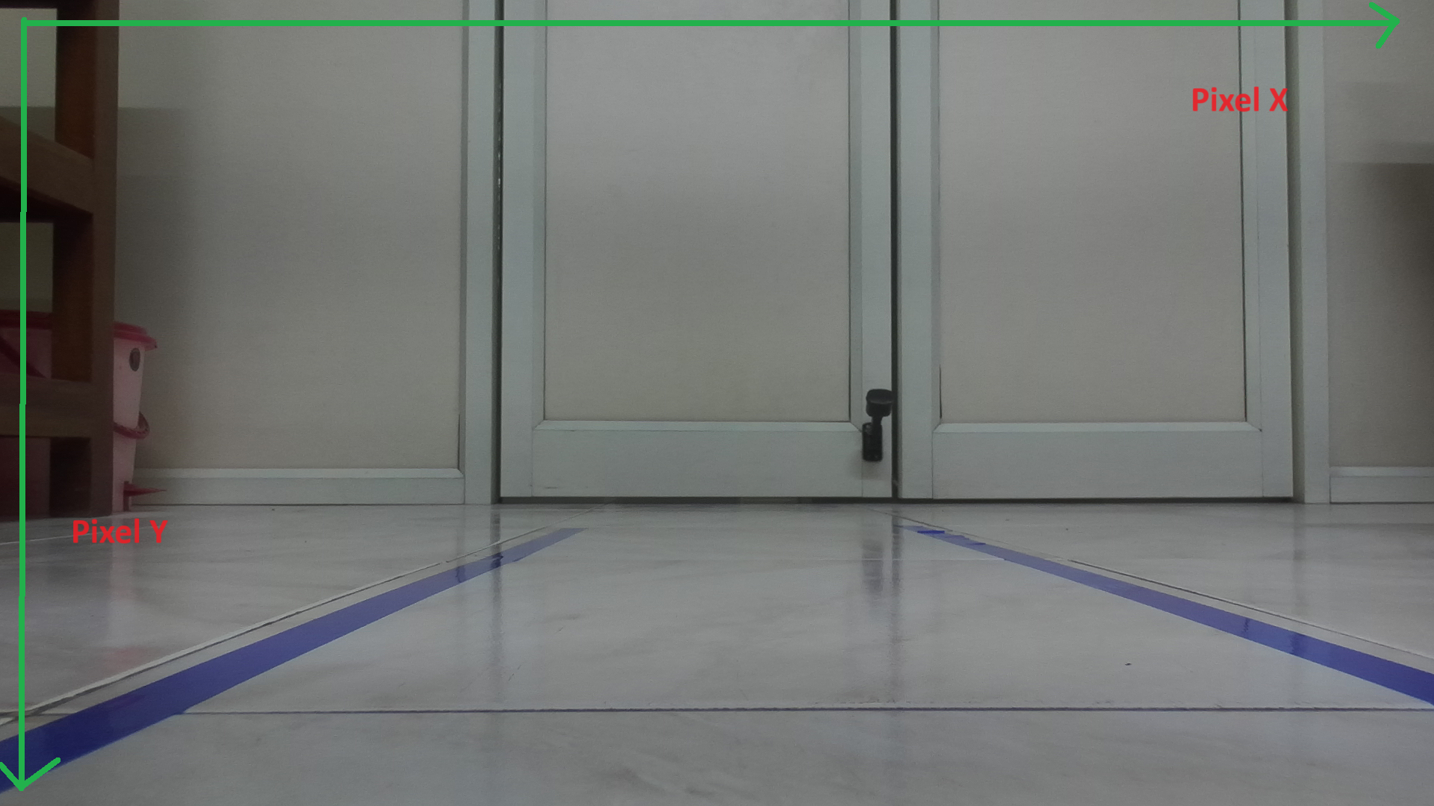
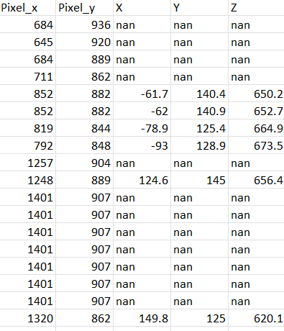
Quantification of the accuracy without object
The accuracy of the getting the depth of a point without any object is almost 0
Most of the times gives a nan value as the output
On other times the value is simply out of range
ex: A point 25 cm from camera will be measured as 132 cm
Very few, 1 on 10 gave an accurate estimation of the depth to the +- 5 cm accuracy

Slide 26
Solution to the depth estimation problem
Inverse perspective mapping

Slide 27
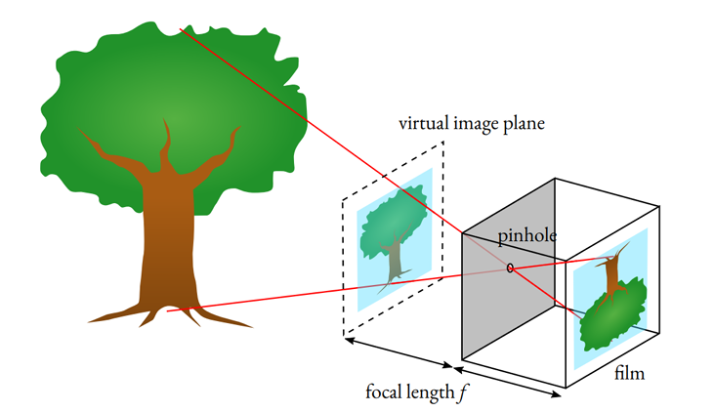
Pinhole Camera Model
Concept and Setup:
The camera coordinate system originates at the pinhole.
The image sensor is inside a confined box with a small aperture (pinhole).
Only a single light ray reaches each point on the sensor, resulting in an upside-down image.
Practical Considerations:
Pinhole cannot be infinitesimally small; too small an aperture results in dim images.
Enlarging the aperture introduces blur due to light rays converging at the same sensor point.
Real cameras use lenses to focus light and mitigate blur.

Slide 28
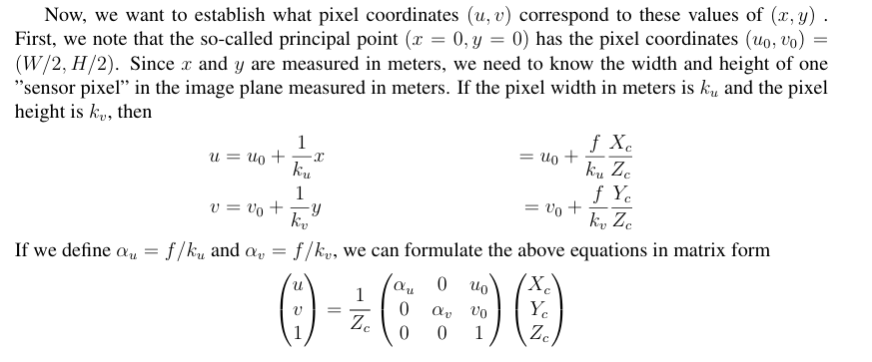
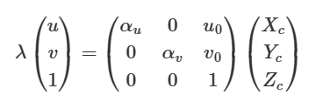
Mapping to Pixel Coordinates

Slide 29
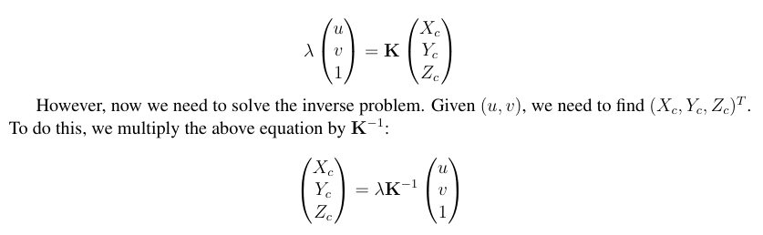
Pixels to meters

Slide 30
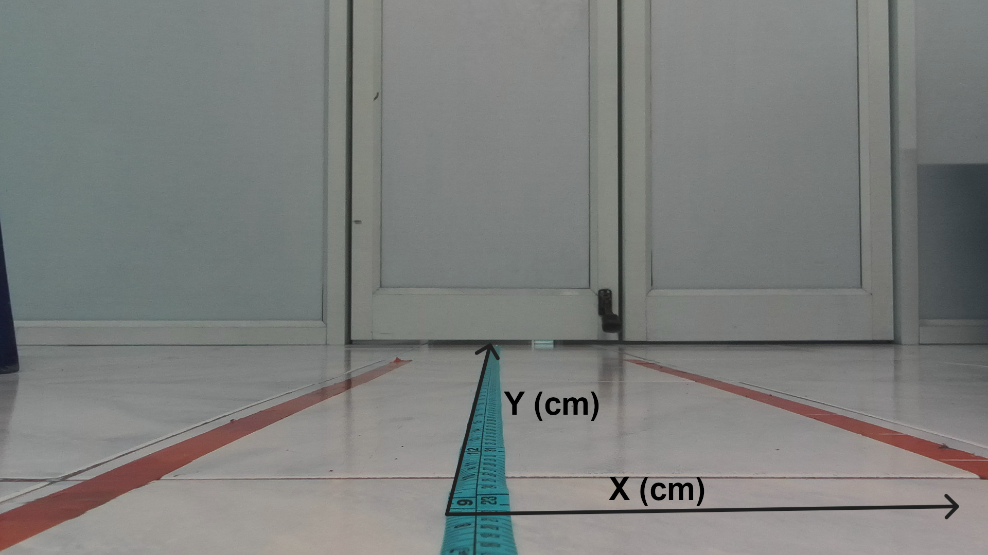
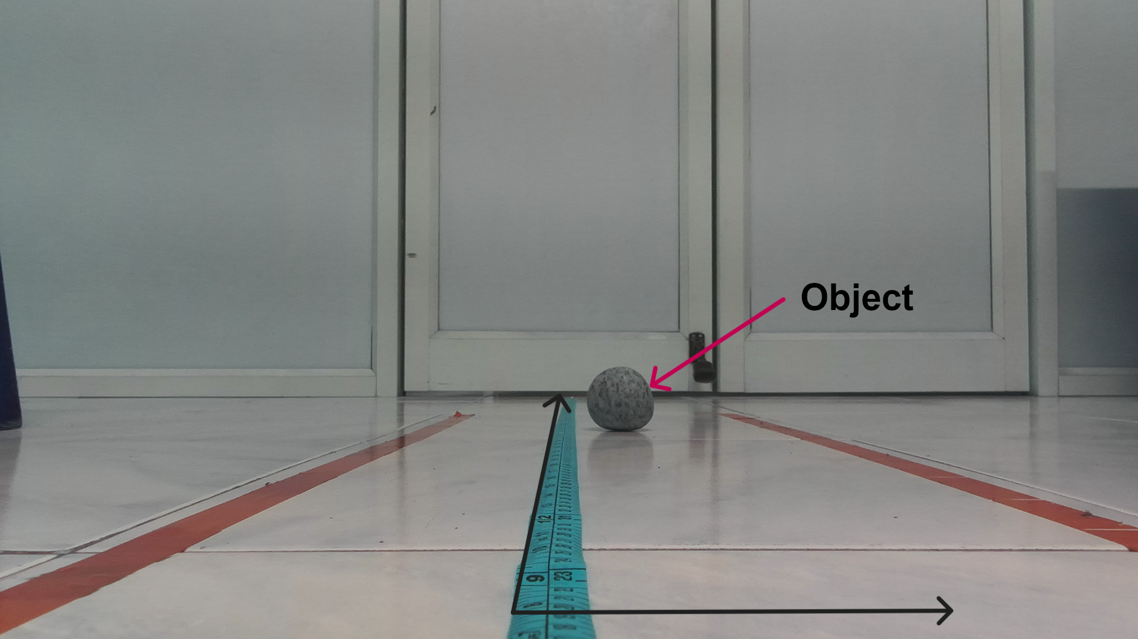
Results of Depth estimation using IPM
Experimental Setup:
Camera height: 5.5 cm.
Scale on ground for reference distances.
Left camera as the origin.
Depth Estimation:
Used inverse perspective mapping (IPM).
Measured ground points within ± 40 cm width and 100 cm depth.
Accuracy Check:
Compared estimated depths with ground truth.
Evaluated method accuracy and reliability.

Slide 31
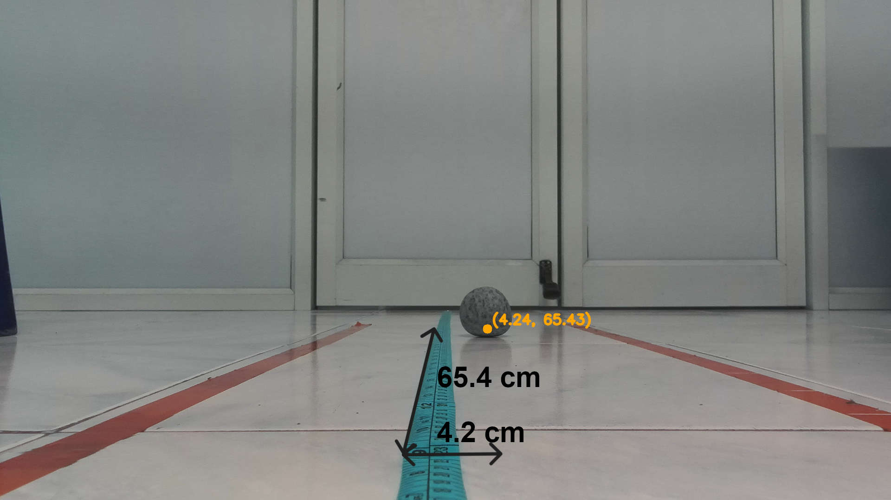
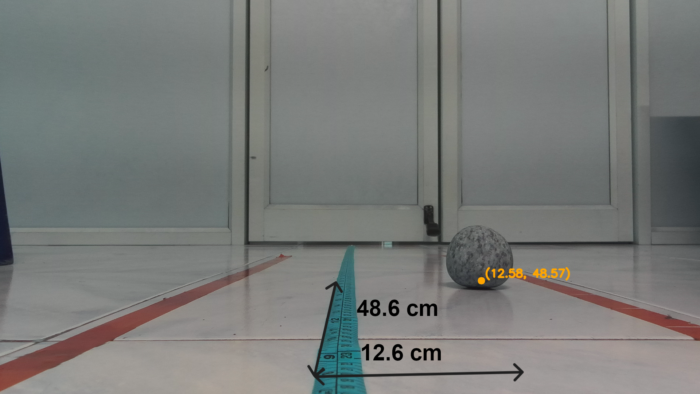
Depth estimation using Inverse Perspective

Slide 32
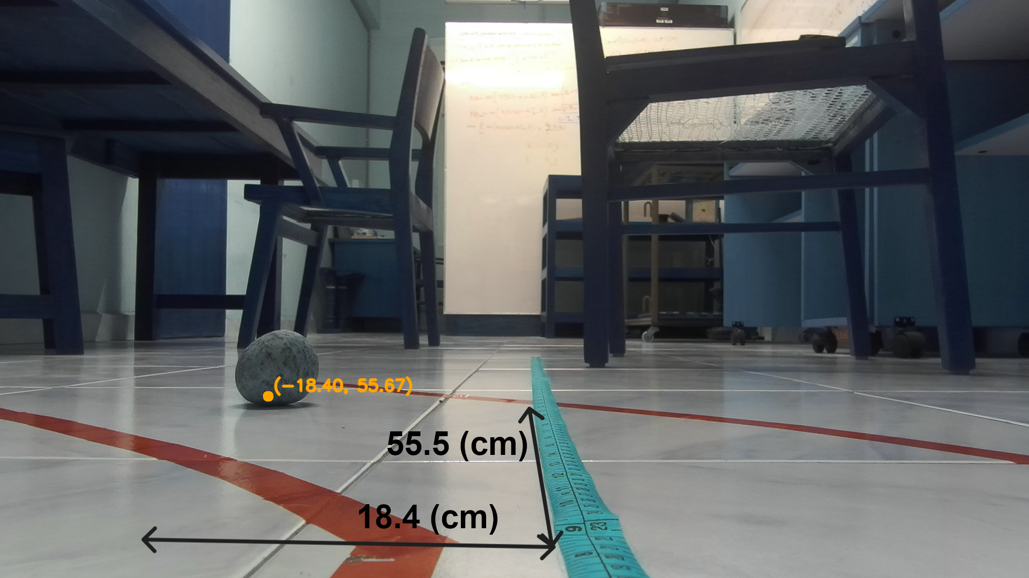
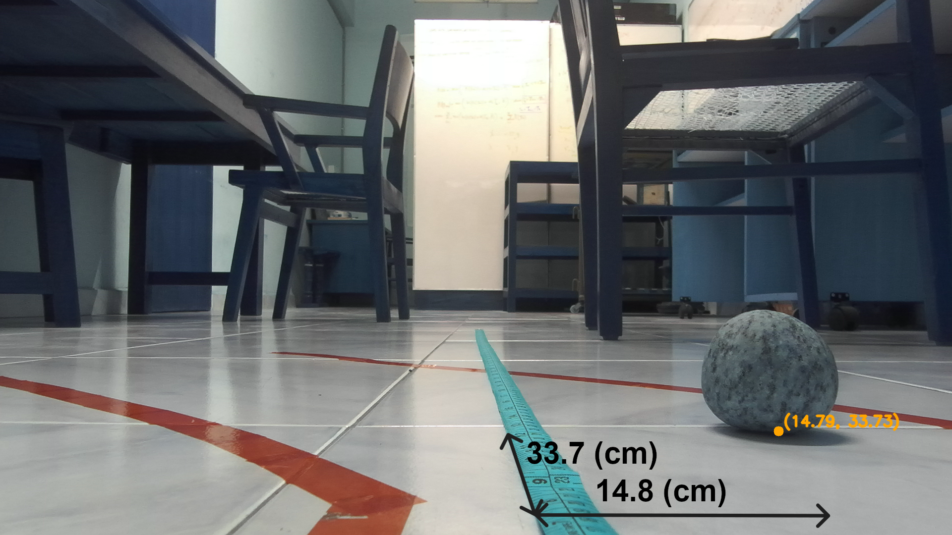
Depth estimation results

Slide 33
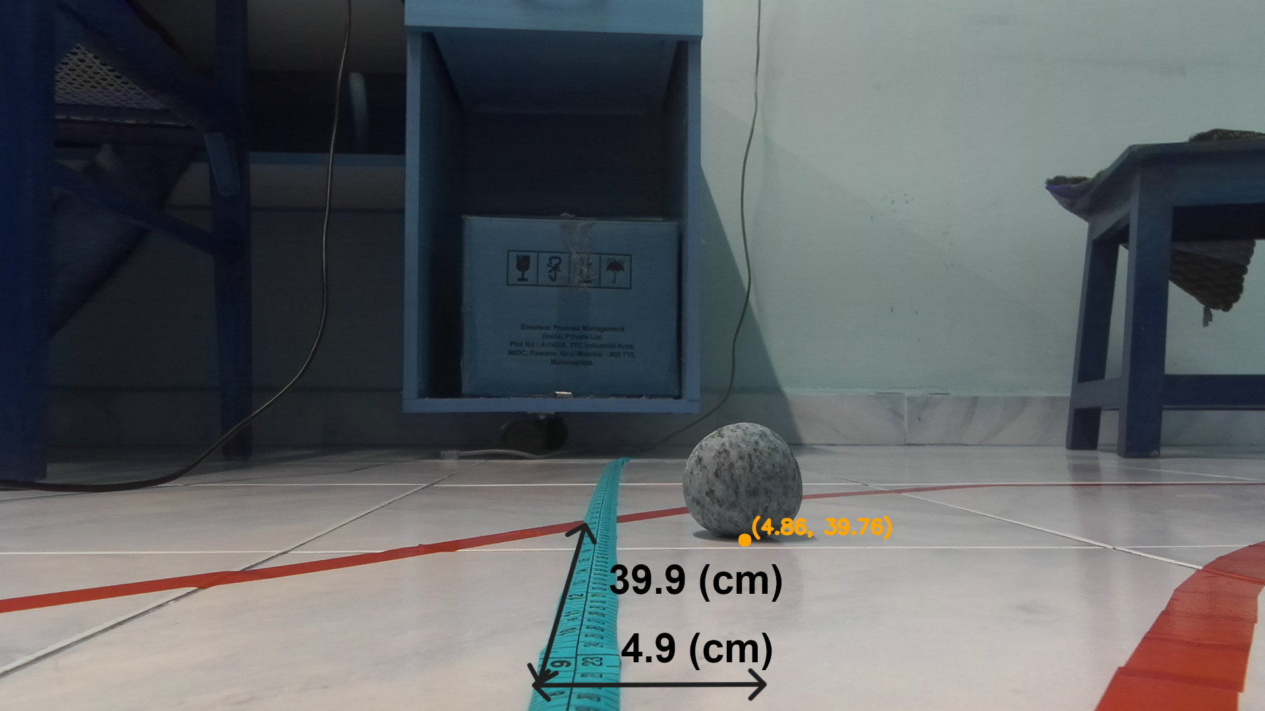
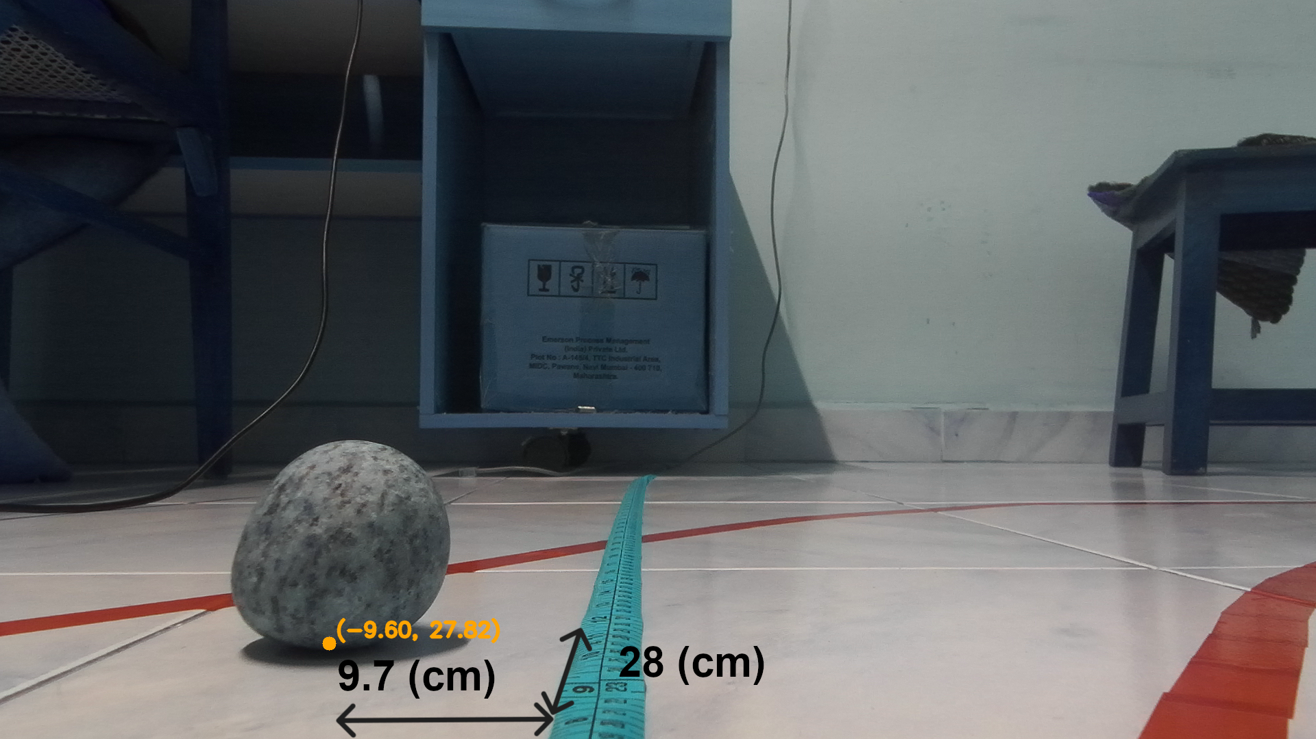
Depth estimation results

Slide 34
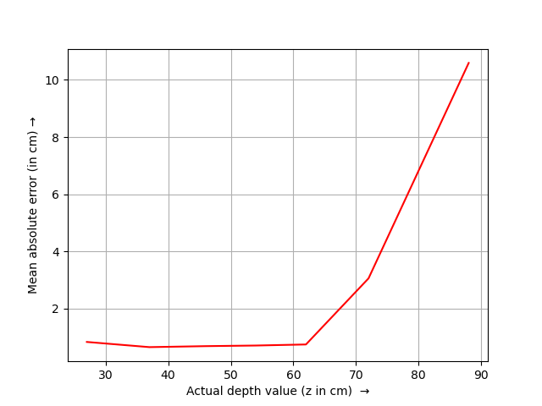
Error vs Depth plot for IPM
Distance Intervals:
Measured points from 20 cm to 90 cm in 10 cm intervals.
Ten points measured at each interval.
Mean Absolute Error:
Calculated and plotted error vs. distance.
Method shows high accuracy up to 70 cm with < ±3 cm error.
Performance at Greater Depths:
Error within ±10 cm at 90 cm depth.
Demonstrates method's suitability for depth estimation.

Slide 35
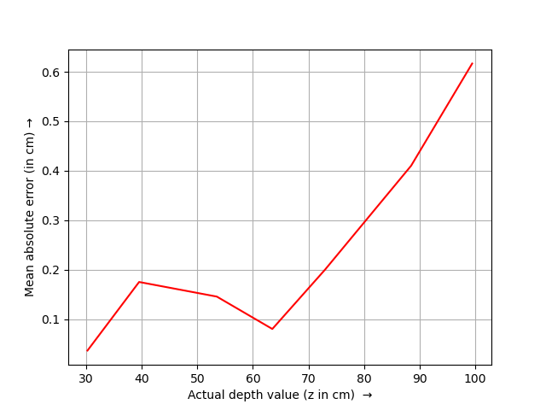
Error vs Depth plot for zed
Experimentation with Built-in Point Cloud Methods:
Utilized ZED camera's point cloud methods for object detection and depth estimation.
Setup similar to previous experiments, but measured object depth directly.
Results:
Mean absolute error in depth estimation demonstrated in the figure.
Accurate depth estimates within our range of interest.
Conclusion:
Both methods offer reliable depth estimates.
Suitable for integration into path planning algorithms.

Slide 36
Final path planning algorithm

Slide 37
Final path planning algorithm
Capture an image using the ZED camera.
Transmit the captured image to the server computer.
Perform image segmentation to identify the drivable area.
Extract extreme points corresponding to white pixels along a given horizontal line in the image using the two-pointer approach.
Iterate this process across the entire image to obtain multiple sets of extreme points.
Compute the average pixel values for each set of extreme points and determine the midpoints along the vertical axis.
Estimate the corresponding x and y values for these midpoints, which serve as the waypoints.
Transmit these waypoints back to the vehicle and navigate it to follow this path.
Repeat the process from step 1.

Slide 38
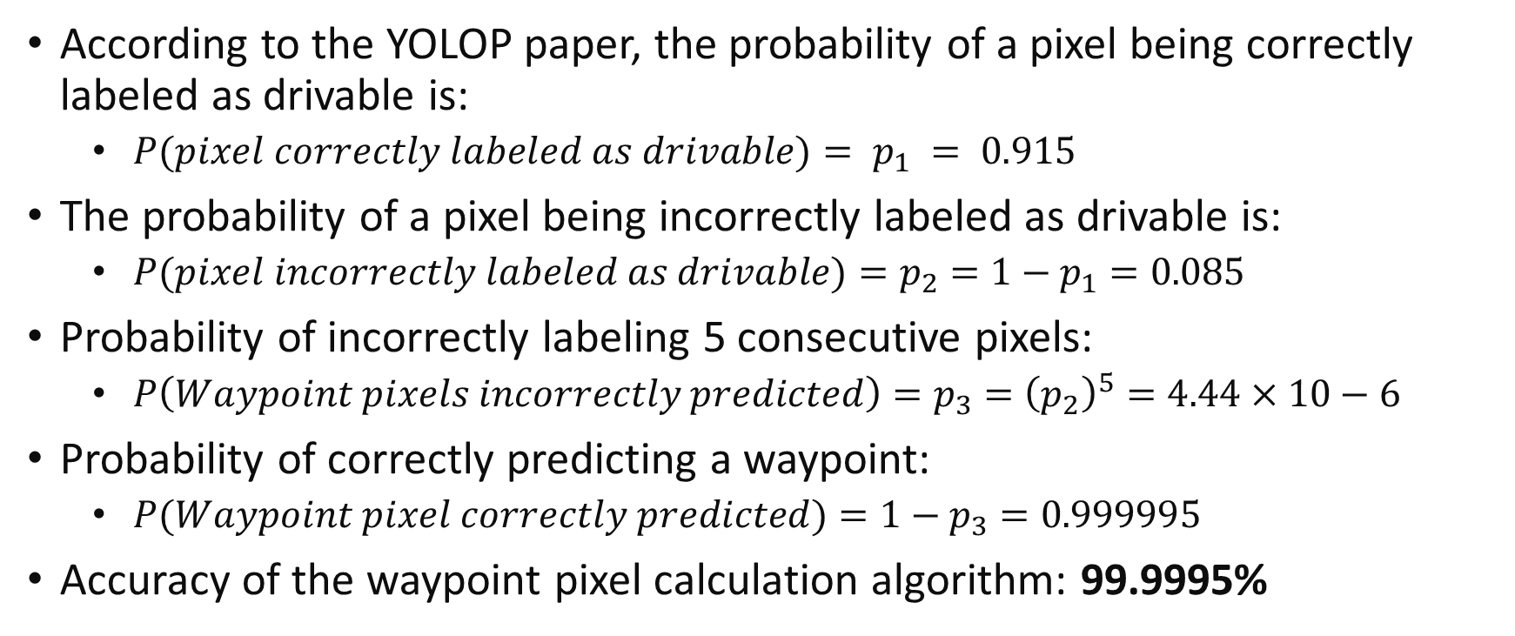
Probabilistic estimation of accuracy
According to the YOLOP paper, the probability of a pixel being correctly labeled as drivable is:
$P(pixel correctly labeled as drivable)= p_{1} = 0.915$
The probability of a pixel being incorrectly labeled as drivable is:
$P(pixel incorrectly labeled as drivable)=p_{2}=1−p_{1}=0.085$
Probability of incorrectly labeling 5 consecutive pixels:
$P\left(Waypoint pixels incorrectly predicted\right)=p_{3}={\left(p_{2}\right)}^{5}=4.44×10−6$
Probability of correctly predicting a waypoint:
$P(Waypoint pixel correctly predicted)=1−p_{3}=0.999995$
Accuracy of the waypoint pixel calculation algorithm: 99.9995%

Slide 39
Global Waypoint Generation

Slide 40
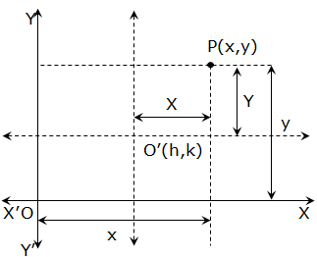
Why are global waypoints needed?
To synchronize between two different frames.
To ensure consistency in the output.
Provides a common reference for navigation and coordination.
Enhances the accuracy of the vehicle's path planning.
Facilitates seamless integration with the car's control module.

Slide 41
Global Waypoint Generation
Concept:
Map all waypoints relative to a designated origin point, typically the starting position of the vehicle.
Algorithm:
Estimate current waypoints relative to the vehicle's current position.
Add coordinates of the current position using the IMU sensor of the car.
Benefit:
Ensures waypoints are referenced to a consistent global coordinate system.
Enables accurate navigation.
Origin Shifting

Slide 42
Global Waypoint Generation Algorithm
Define the origin point as the starting position of the vehicle.
Initialize empty lists to store relative waypoints and global waypoints.
Acquire current position coordinates using the IMU sensor.
For each detected waypoint:
Calculate the relative coordinates of the waypoint relative to the current position.
Add the current position to the relative waypoint coordinates to obtain global coordinates.
Append the global coordinates to the list of global waypoints.
Output the list of global waypoints.

Slide 43
Summary of Results
Segmentation
Waypoint Generation

Slide 44
Summary of Results
Depth estimation
Error curves

Slide 45
Final Flow of Algorithm
And after finding these way points releative to the current position we use the IMU sensors of the car to get the global way points.

Slide 46
Demo

Slide 47
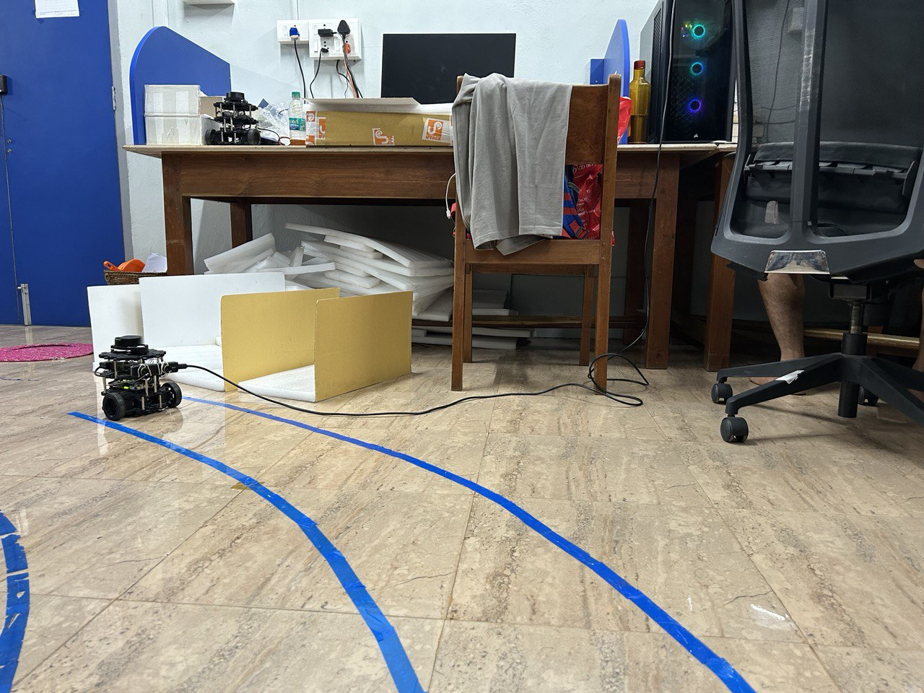
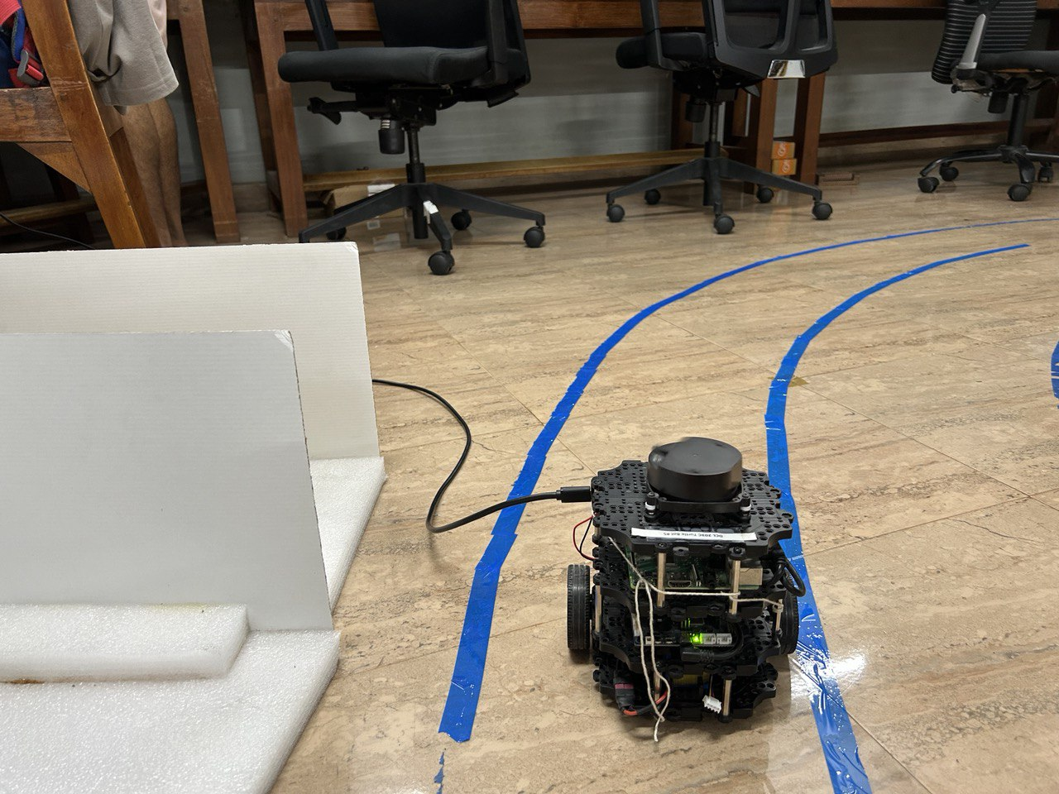
Demo of the software module
We create tracks with a width of 5 cm and include a slight curve.
The camera is positioned at a height of 8 cm on the TurtleBot.
The TurtleBot is connected to a server computer.
We observe the video recorded by the TurtleBot and the corresponding output of waypoints captured on the server computer.

Slide 48
Conclusion
Developed and integrated a sophisticated software module for one-tenth scale autonomous vehicles.
Utilized the YOLOP model for accurate scene segmentation and enhanced navigation capabilities.
Conducted rigorous experimentation with depth estimation methods, waypoint generation ensuring system reliability and accuracy.
Demonstrated the efficacy of scaled-down vehicles for controlled testing of autonomous driving algorithms, reducing full-scale testing risks.

Slide 49
Ongoing Work
Conduct an experiment to navigate the car over a pre-constructed track in a controlled lab environment.
Use the control module to navigate the car and validate the effectiveness of the developed algorithms.
Create clear and detailed documentation of the code.
Ensure future developers can easily use and modify the code.
Continuously refine and improve the navigation algorithms based on experimental outcomes.

Slide 50
References
Dong Wu, Manwen Liao, Weitian Zhang, Xinggang Wang, Xiang Bai, Wenqing Cheng, Wenyu Liu, YOLOP: You Only Look Once for Panoptic Driving Perception, 2022. (Link to paper)
Wouter Van Gansbeke, Bert De Brabandere, Davy Neven, Marc Proesmans, and Luc Van Gool, End-to-end lane detection through differentiable least-squares fitting, 2019. (Link to paper)
Richard Hartley and Andrew Zisserman, Multiple view geometry in computer vision, Cambridge University Press, 2003. (Link to reference)

Slide 51
Questions

Slide 52
Thank You

